Slide 1
Multimodal Visual Question Answering Using BLIP-2
Rakshya Chaudhary
Student ID:24048771

Slide 2
PROBLEM STATEMENT & MOTIVATION
  Traditional VQA system:
Use fixed answer vocabularies
Performed poorly in real-world scenarios
Often rely on language bias
Goal: To develop a flexible, generative VQA model that produces answer based on both image and question

Slide 3
OBJECTIVE
  To use pre-trained BLIP-2 model in VQAv2 dataset for generative question answering
  To compare the proposed approach with traditional VQA with fixed vocabulary
  To evaluate the qualitative and quantitative performance of model

Slide 4
DATASET AND EDA
Dataset: VQAv2
EDA
  MS-COCO images
  Open-ended question
  10 ground-truth answers per question
  Question Type Frequency Analysis
  Answer Frequency and Long-Tail Distribution
  Answer Variability and Annotator Agreement
  Qualitative Multimodal Examples
  Question Length Distribution

Slide 5
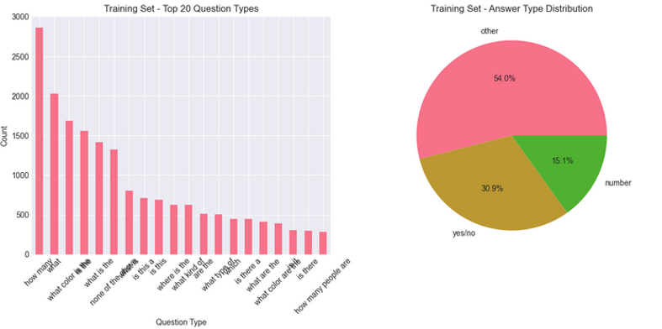
EDA 1: Question Type Frequency Analysis
shows different types of questions in the dataset and their imbalance

Slide 6
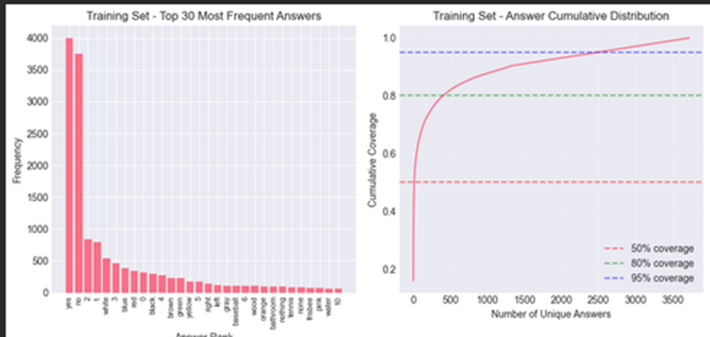
EDA 2: Answer Frequency and Long-Tail Distribution
shows strong long-tail answer imbalance, motivating use of generative VQA model instead of a fixed-vocabulary approach

Slide 7
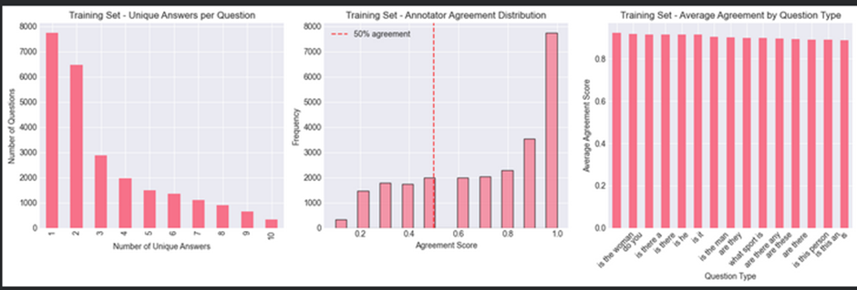
EDA 3: Answer Variablitlity and Annotator Agreement
Analyses multiple human answers per question
Reveals high aggreement for clear imahes and variablity for ambiguous cases.

Slide 8
MODEL ARCHITECTURE
Model: BLIP-2
Three Components:
  Vision Transformer (ViT)
  Querying Transformer (Q-Former)
  Large Language Model (OPT-2.7B)

Slide 9
TRAINING
  Model fine-tuned on 5000 images
  3000 images for validation and 2000 images for testing and evaluation
  Trained using PyTorch and AdamW optimizer for 3 epochs, batch_size 8
  Final Training loss and validation loss: 0.500 and 0.426

Slide 10
INFERENCE PIPELINE
Input: Image + Question
Process:
  Image and question jointly encoded
  Model generates answer token-by-token
Output:
  Natural Language answer (not fixed labels)

Slide 11
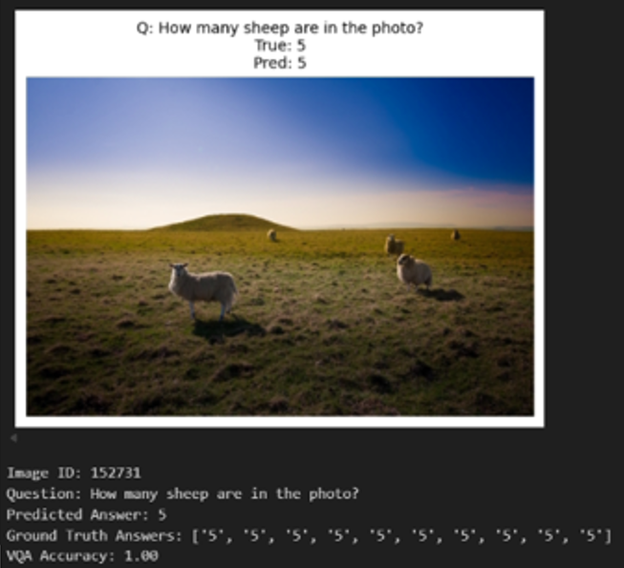
EVALUATION METHODS & RESULTS
  Metric: VQA Accuracy: 48%
  Evaluation on 2000 test samples
  Quantitative accuracy and qualitative Visualization
  Strong performance on object and action questions

Slide 12
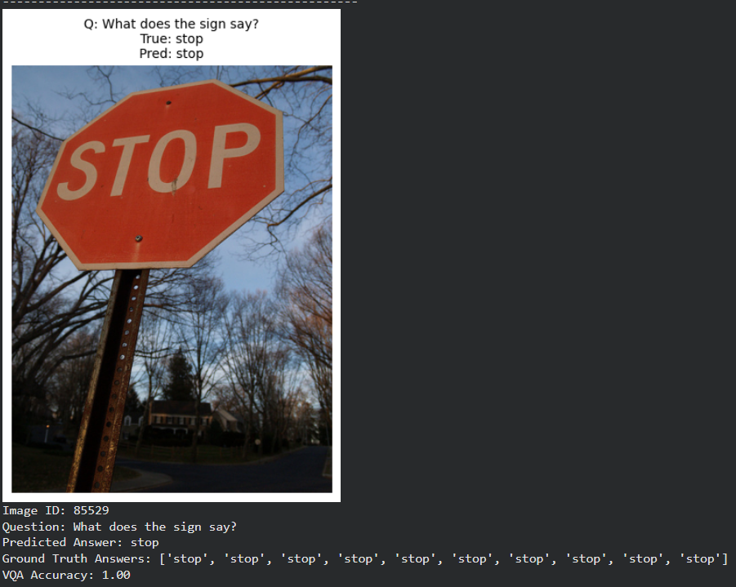
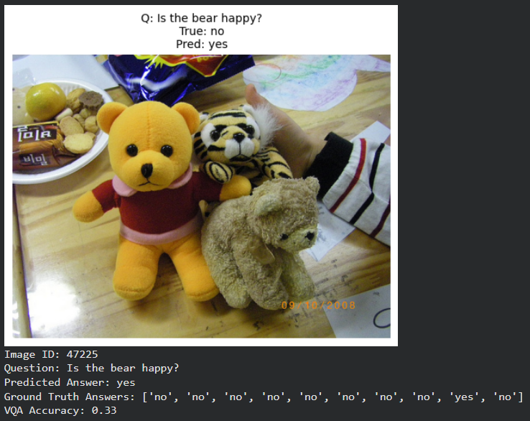
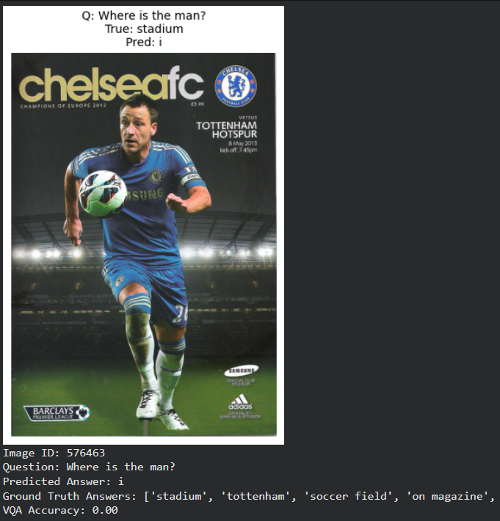
Qualitative Evaluation

Slide 13
DISCUSSION AND LIMITATION
Achievements:
  Overcomes fixed-answer limitations
  Flexible and generative responses
Limitations:
  Trained on reduced dataset
  Open ended questions, confusing and reasoning questions remain challenging

Slide 14
Conclusion:
  Successfully developed a generative VQA model
  Demonstrated for real-world scenarios
CONCLUSION & FUTURE WORK
Future Work:
  Larger datasets
  Advanced architecture
  Real-time deployment

Slide 15
Thank You

